Slide 1
Mask R-CNN
Instance Segmentation on squirrel Squirrel
A Computer Vision Project
Yongchang Feng
Thanks my teammates YingFan Xu and Gloria Sun

Slide 2
Overview
Introduction Mask R-CNN
Prepare Dataset
Training
Inference

Slide 3
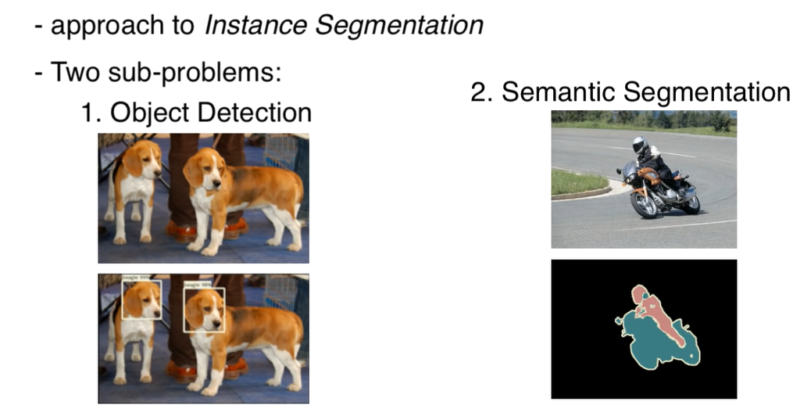
Instance Segmentation
Object Detection + Semantic Segmentation = Instance Segmentation
Mask R-CNN is one of the method to achieve instance segmentation

Slide 4
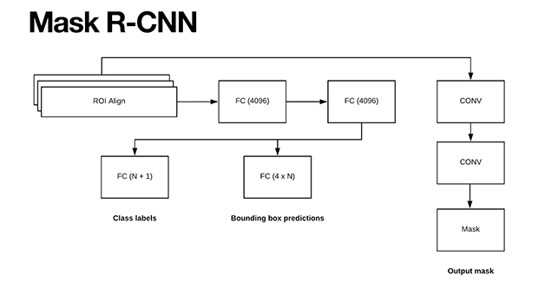
Mask RCNN
Mask R-CNN = Faster R-CNN + FCN
Faster R-CNN is widely used for object detection tasks (it returns the class label and bounding box coordinates).
ROI align preserves spatial orientation of feature with no loss of data
The Mask R-CNN architecture by He et al. enables object detection and pixel-wise instance segmentation.
The Mask R-CNN model has evolved from three preceding architectures for object detection:
R-CNN: Selective Search and then feature extraction and classification using a pre-trained CNN.
Fast R-CNN: Selective Search and adds the Region of Interest (ROI) Pooling module.
Faster R-CNN: Introduces the Regional Proposal Network (RPN) that bakes the region proposal directly into the architecture, alleviating the need for the Selective Search algorithm.

Slide 5
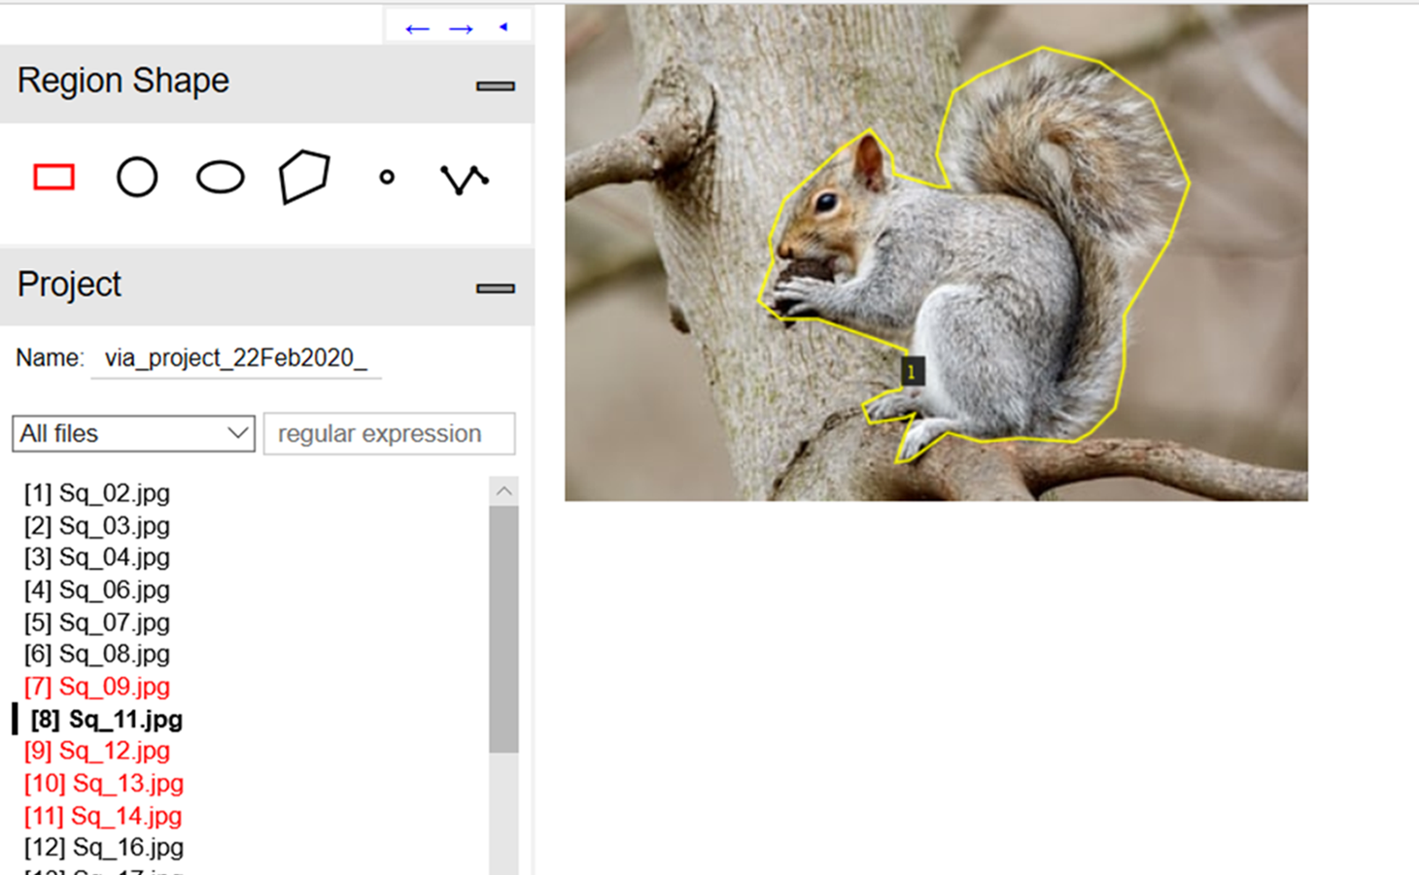
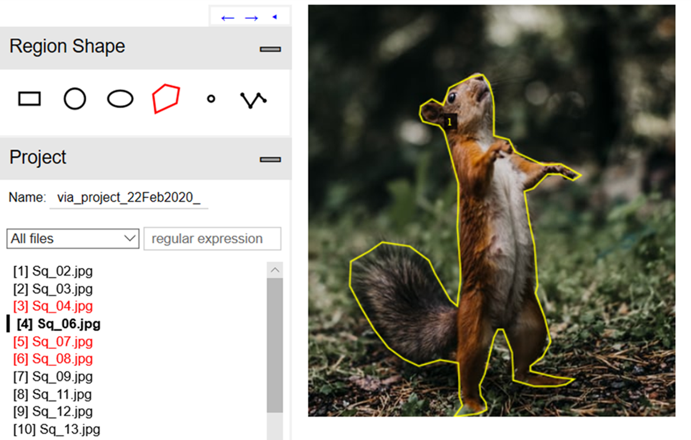
Prepare Dataset
60 squirrel pictures have been collected, 54 for training and 6 for validation
Each picture are annotated using VGG Image Annotator (http://www.robots.ox.ac.uk/~vgg/software/via/)

Slide 6
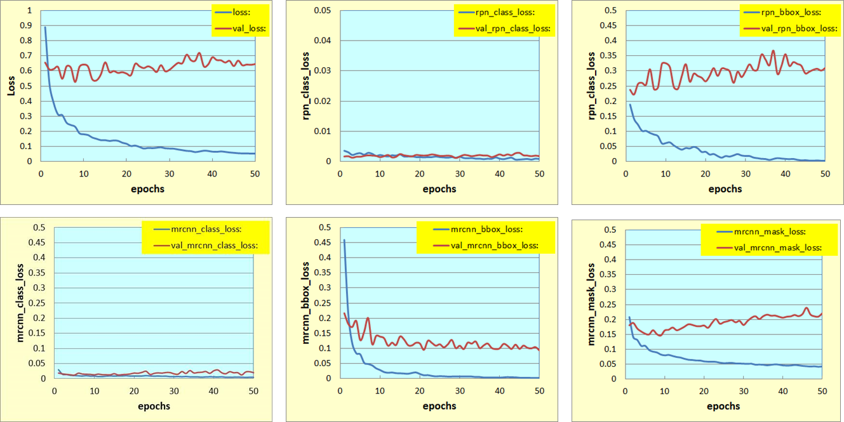
Training
RPN
Mask R-CNN
Classification
BBox
Mask
Use transfer learning, weight from COCO
Classification loss is low
Validation loss is significantly higher in bbox_loss and mask_loss than the training loss – overfitting due to small sample size

Slide 7
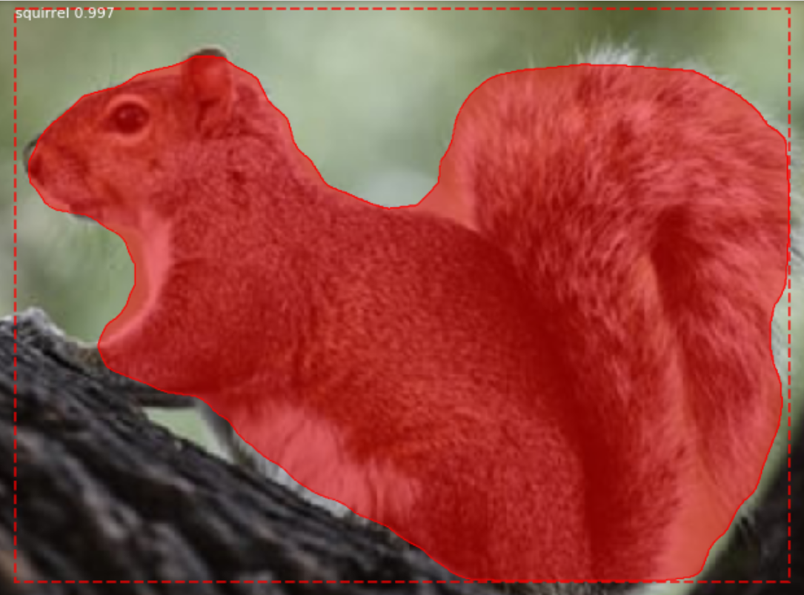
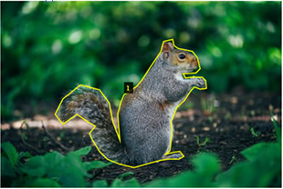
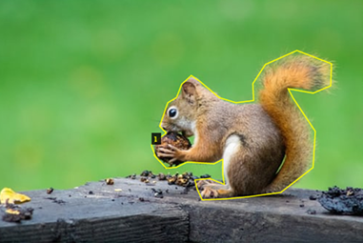
Results and Discussion
In most cases, the instance segmentation is mostly correct.

Slide 8
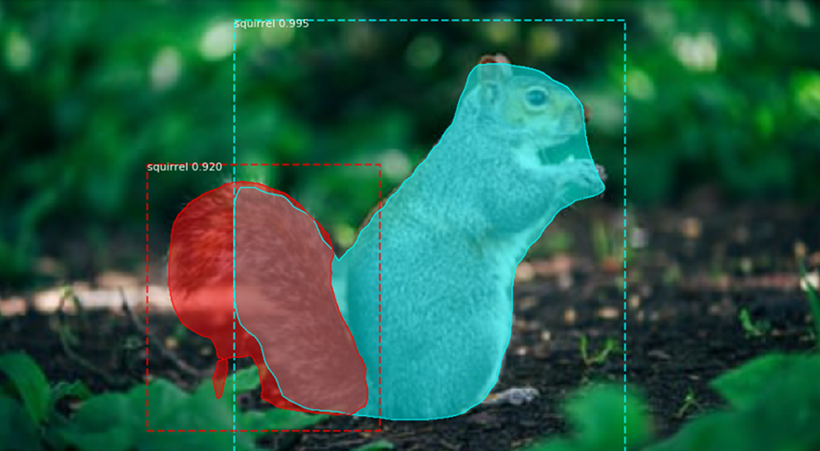
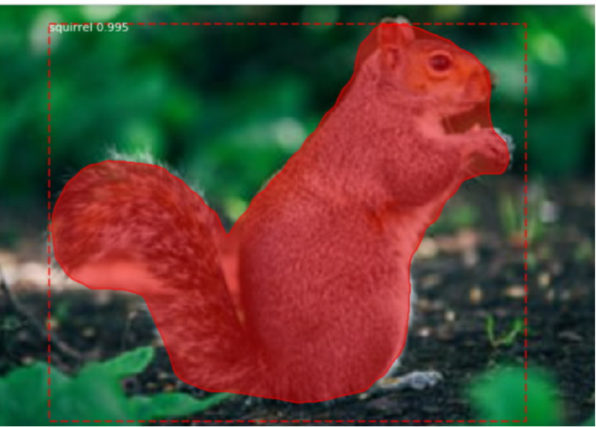
Results and Discussion
Epochs = 3: Train loss > 0.3 and Val loss > 0.6
Mis-segmentation – one squirrel was split into two.
Epochs > = 5: train loss < 0.3 and val loss < 0.6,
the squirrel is correctly detected and segmented.

Slide 9
Summary
In this computer vision class project, a Mask R-CNN model is trained for instance segmentation on squirrels.
With a very small training sample size (56), the model work reasonable well.
Larger training sample size and data augmentation could improve the model further.

Slide 10
Reference
Mask R-CNN https://arxiv.org/abs/1703.06870
How to Train an Object Detection Model with Keras https://machinelearningmastery.com/how-to-train-an-object-detection-model-with-keras/
Keras Mask R-CNN https://www.pyimagesearch.com/2019/06/10/keras-mask-r-cnn/
matterport/Mask_RCNN https://github.com/matterport/Mask_RCNN
Computer Vision Tutorial: Implementing Mask R-CNN for Image Segmentation https://www.analyticsvidhya.com/blog/2019/07/computer-vision-implementing-mask-r-cnn-image-segmentation/
Object Detection: Step-by-Step Guide on Mask R-CNN https://towardsdatascience.com/object-drones-detection-step-by-step-guide-on-mask-r-cnn-7bec0fb09a1
Building a Custom Mask RCNN model with Tensorflow Object Detection https://towardsdatascience.com/building-a-custom-mask-rcnn-model-with-tensorflow-object-detection-952f5b0c7ab4
https://colab.research.google.com/github/RomRoc/maskrcnn_train_tensorflow_colab/blob/master/maskrcnn_custom_tf_colab.ipynb
VGG Image Annotator (http://www.robots.ox.ac.uk/~vgg/software/via/)
Instance Segmentation using Mask R-CNN on a custom dataset

Slide 11
Mask RCNN

Slide 12
ROI Align
ROI align preserves spatial orientation of feature with no loss of data

